Slide 1
Machine Learning
Project Slides – AA 2018/2019 Student: Ivan Capponi

Slide 2
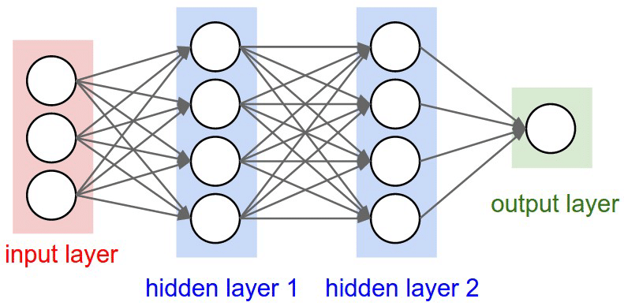
Developping a simple neural network in Python

Slide 3
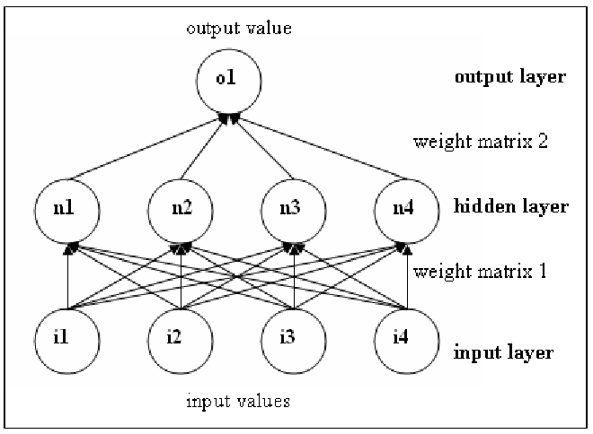
Initializing the neural network structure
2 layers of neurons;
One matrix to represent the weights from the input layer to the hidden layer
One array vector to represent the weigths from the hidden layer to the output

Slide 4
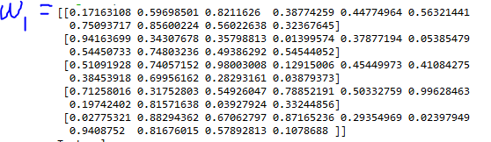
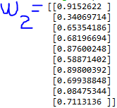

Weights and layers structure
Let $X∈ℝ^{n x m}$ the input layer, $Y∈ℝ^{t}$ the test vector.
Weights matrix $w1∈ℝ^{mx n}$, and it is initialized randomly with values $∈\left(0,1\right)$ .
Weigths vector $w2∈ℝ^{n}$, it is initialized randomly as well.

Slide 5


FeedForward procedure
Let $σ:ℝ^{J x K}→ℝ^{J x K}$ an activation function and $b_{1}…b_{n}$ some biases.
FeedForward procedure tries to predict values for the output vector $\hat{y}$
In this implementation I have chosen $σ=\frac{1}{1+e^{−x}}$ and $b_{1}…b_{n}=0$.

Slide 6


Loss Function and BackPropagation procedure
The Loss Function evaluates how accurate the predicted output values are.
We define $loss\left(y,\hat{y}\right)=\sum_{i=1}^{n}{{\left(y−\hat{y}\right)}^{2}}$.
BackPropagation procedure has the task to propagate the error back, updating neural network weights
Derivative of sigmoid function can be computed as follows: $σ\left(x\right)\left(1−σ\left(x\right)\right)$.

Slide 7

Training the neural network
We choose an integer number $E$, representing the epochs (number of iterations of the training algorithm).
The training algorithm is really simple: $for \left(i=1 …E\right)\{$ $\text{FeedForward}\text{(}\text{nn}\text{);}$ $BackPropagation\left(nn\right);$ $\}$
We can finally take a look at our prediction vector$\hat{y}$.

Slide 8
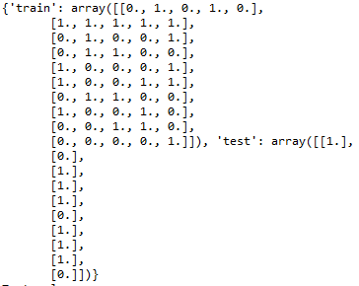

Generating a dataset for training purposes
Let’s generate in Python a dataset in order to train the neural network
For simplicity we generate an integer matrix $M∈ℝ^{n x m}$ containing only zeros and ones, randomly distributed in $M$.
We want to predic whether the sum of rows is even (0) or odd (1), so we generate the right test vector $Y$ for this task.

Slide 9
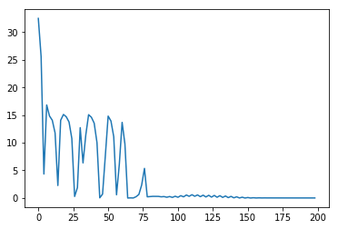

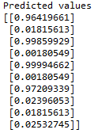

Training the neural network with the generated dataset
Assuming $M∈ℝ^{10 x 5}$ , training was performed successfully on 500 epochs (even thought 100 iterations would have been just fine):
X axis is the epoch number Y axis is the loss function value

Slide 10
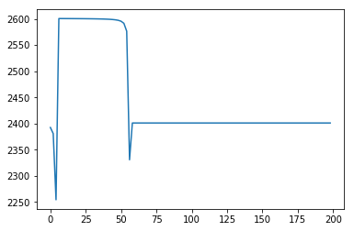

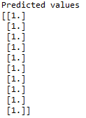

On big datasets, results were not satisfactory
Assuming $M∈ℝ^{100 x 50}$ , training could not be performed successfully.

Slide 11
Thanks for your attention

